Slide 1
Final Project of Machine Vision Motion Prediction
Adviser: Prof. Chi Cheng Cheng
Student: Chia Sheng Kuo
Student ID: M063020037
Dept. of Mechanical and Electro-Mechanical Engineering National Sun Yat-Sen University

Slide 2
Outline
Strategy
Method
Result

Slide 3
Strategy

Slide 4
Block diagram of the proposed procedure
Input Image Sequence
Set up a coordinate system
Preprocessing for Image matching
Data analyzing
Predict the position and velocity

Slide 5
Method

Slide 6
Input Image Sequence
Set up a coordinate system
Preprocessing for Image matching
Data analyzing
Predict the position and velocity

Slide 7










Coordinate System
B(X,Y,Z)
$$u_{L}$$
5.7mm
L
R
$$u_{R}$$
$$v_{L}$$
$$v_{R}$$
4.29mm
$$x_{L}$$
$$z_{L}$$
$$x_{R}$$
X
$$z_{R}$$
f=6.3mm
$$y_{L}$$
$$y_{R}$$
1100mm
700mm
Z
X (vertical)
Y (horizontal)
O (0,0,0)
Y
Z (depth)

Slide 8
Input Image Sequence
Set up a coordinate system
Preprocessing for Image matching
Data analyzing
Predict the position and velocity

Slide 9
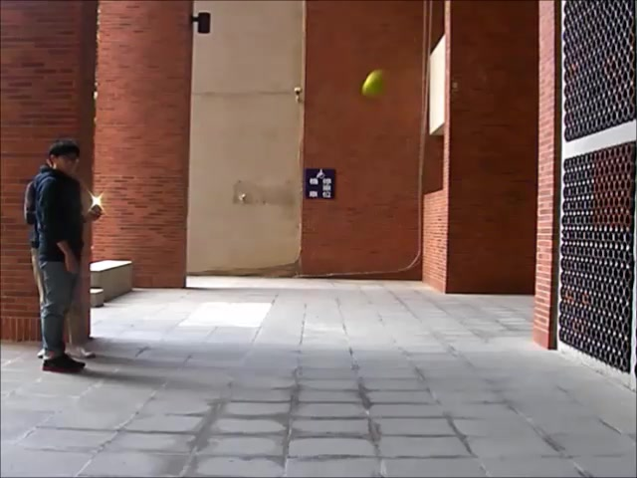
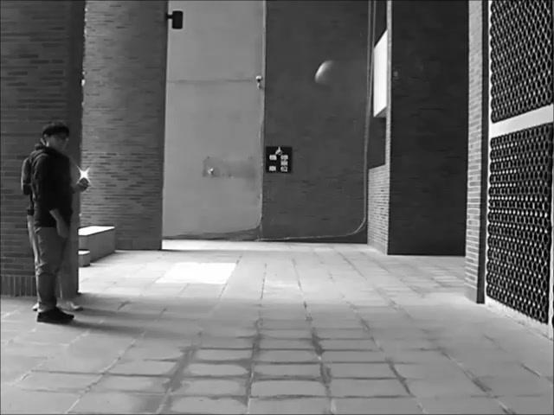









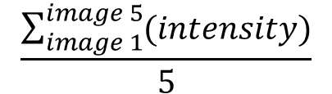
Get ready for image matching
L1
LM
L2
$$\frac{\sum_{image 1}^{image 5}{(intensity)}}{5}$$
L3
=
L4
L5

Slide 10
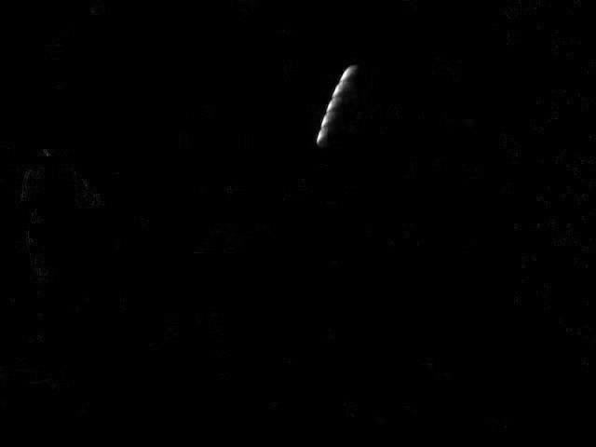





+
+
+
+
$$\left|L1−LM\right|$$
$$\left|L2−LM\right|$$
$$\left|L3−LM\right|$$
$$\left|L4−LM\right|$$
$$\left|L5−LM\right|$$
TAKE_2L
Notes:
Absolute difference

Slide 11
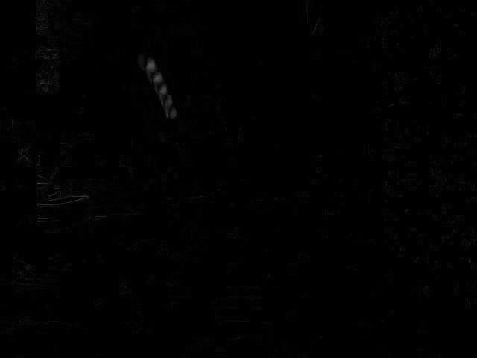
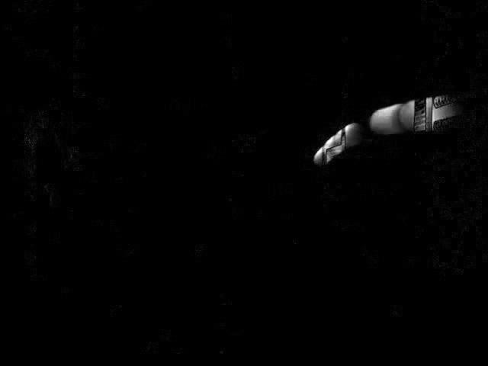
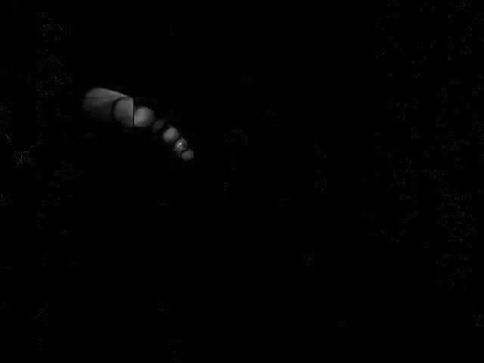
Likewise
TAKE_2R
TAKE_1L
TAKE_1R

Slide 12
Epipolar Constraint
Scene object point
Epipolar
plane
With the epipolar constraint, matching points should lie on the same row of the left image plane and right image plane.
Left image plane
Right image plane
Left camera
lens center
Right camera
lens center

Slide 13




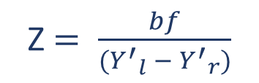


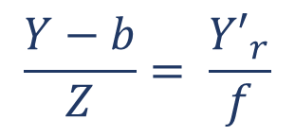

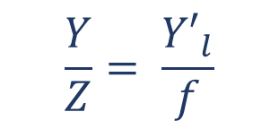


Scene object point
M
N
P(x,y,z)
$$\frac{Y}{Z}= \frac{{Y′}_{l}}{f}$$
(1)
Left camera optical axis
Right camera optical axis
$$\frac{Y−b}{Z}= \frac{{Y′}_{r}}{f}$$
(2)
Z
$${Y′}_{l}$$
$${Y′}_{r}$$
Right image plane
Z $= \frac{bf}{({Y^{′}}_{l} − {Y^{′}}_{r})}$
Left image plane
(1) - (2)
$$O_{L}$$
$$P_{l}$$
$$O_{R}$$
$$P_{r}$$
f
$$C_{l}$$
$$C_{r}$$
${Y^{′}}_{l} − {Y^{′}}_{r}$ is the disparity
Z
O
Left camera
lens center
b
Right camera
lens center
Y

Slide 14

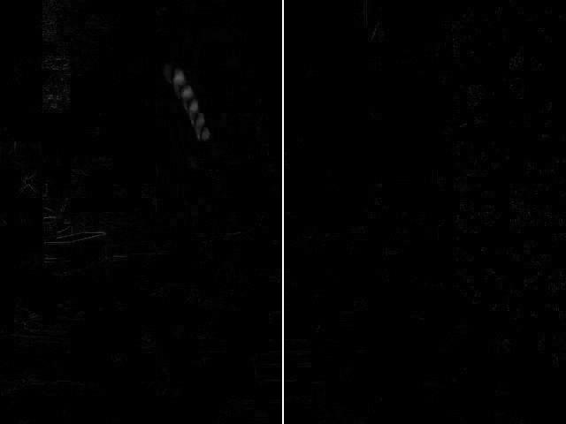


OTSU’s thresholding is applied to each row for finding the accurate matching point.
L
R
$${y′}_{l}$$
$${y′}_{r}$$
Same row

Slide 15
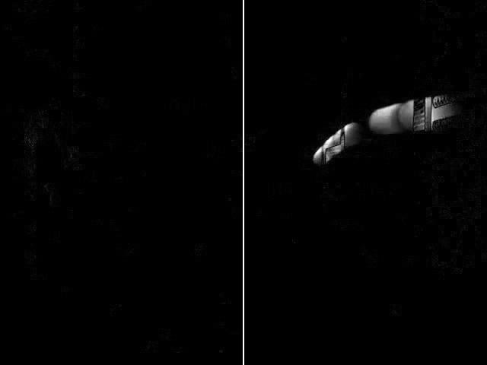
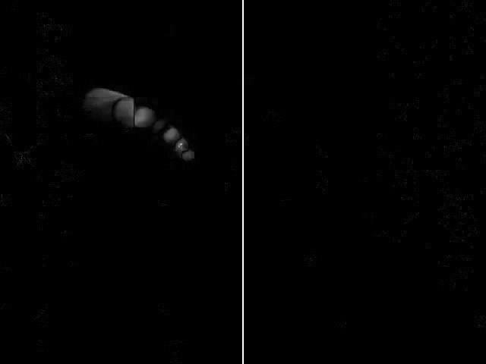

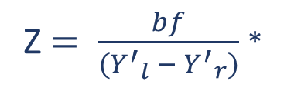


Z $= \frac{bf}{({Y^{′}}_{l} − {Y^{′}}_{r})}$ *
( $\frac{5.7}{640} {mm}/{pixel}$ )
(b=700mm,f=6.3mm)
L
R
$${y′}_{l}$$
$${y′}_{r}$$
Same row

Slide 16




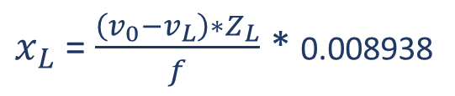


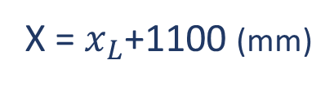

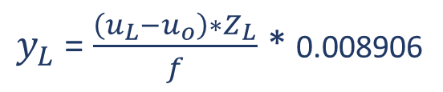

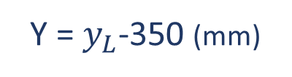




B($x_{L}$,$y_{L}$,$z_{L}$)
$$u_{L}$$
L
$$v_{L}$$
C($u_{o}$,$v_{o}$)
$\frac{u_{L}−u_{o}}{y_{L}}$ = $\frac{v_{o}−v_{L}}{x_{L}}$ = $\frac{f}{Z_{L}}$
B($u_{L}$,$v_{L}$)
f=6.3mm
$$x_{L}$$
$$z_{L}$$
$y_{L}$ = $\frac{\left(u_{L}−u_{o}\right)∗Z_{L}}{f}$ * 0.008906
( $\frac{5.7}{640} {mm}/{pixel}$ )
X
$$y_{L}$$
$x_{L}$ = $\frac{\left(v_{0}−v_{L}\right)∗Z_{L}}{f}$ * 0.008938
( $\frac{4.29}{480} {mm}/{pixel}$ )
1100mm
350mm
Z
Y =${ y}_{L}$-350 (mm)
X =${ x}_{L}$+1100 (mm)
O (0,0,0)
Y
Z =${ z}_{L}$ (mm)

Slide 17
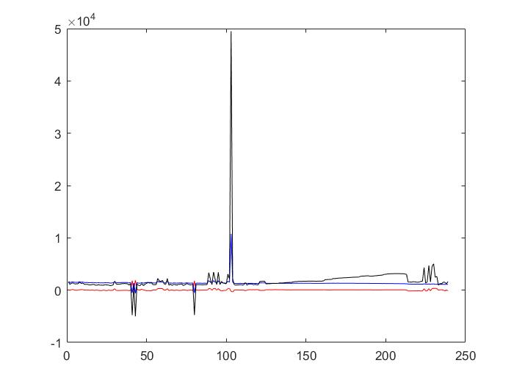
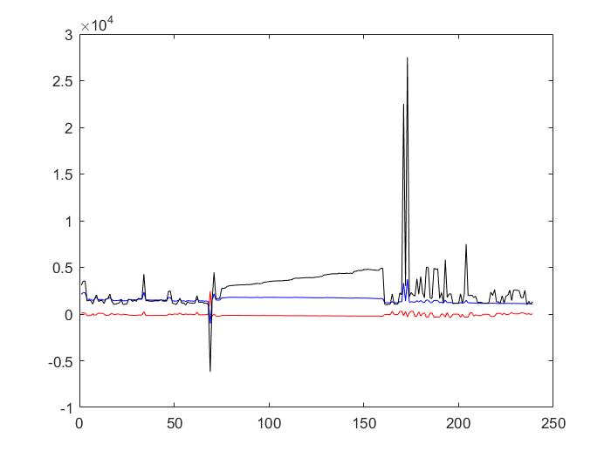
The linear section is affirmed to be the ball position corresponding to the image sequence. This period should be 4/25 second.
X (vertical)
Y (horizontal)
Z (depth)
mm
mm
nth data
nth data
TAKE_1
TAKE_2

Slide 18
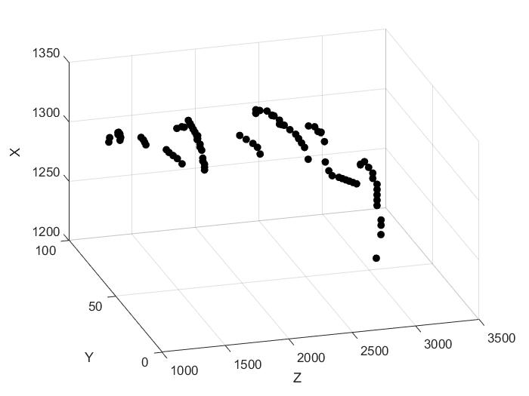
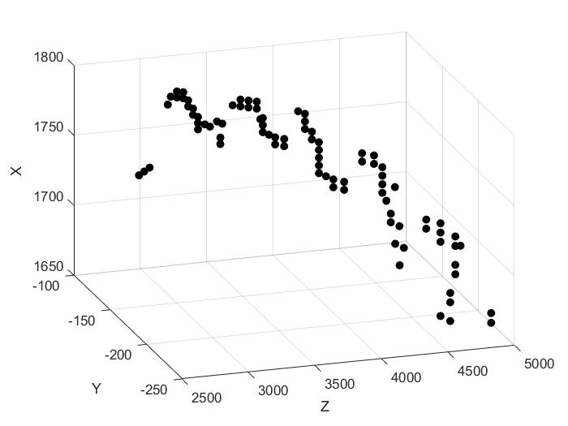
TAKE_1 has 89 data, therefore, it would be $\frac{4}{25∗89}$ s from nth data to (n+1)th data
TAKE_2 has 86 data, therefore, it would be $\frac{4}{25∗86}$ s from nth data to (n+1)th data
mm
mm
TAKE_1
TAKE_2

Slide 19
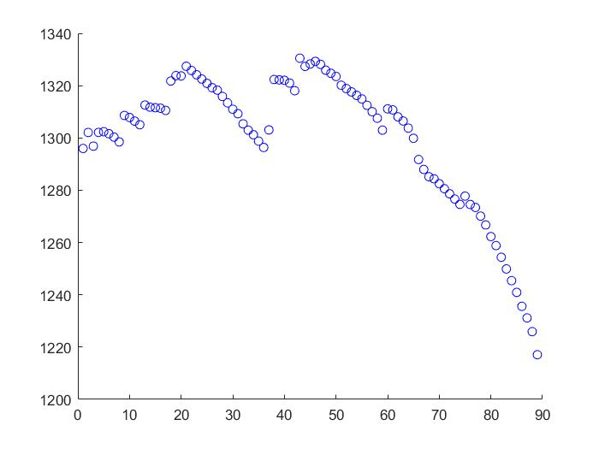
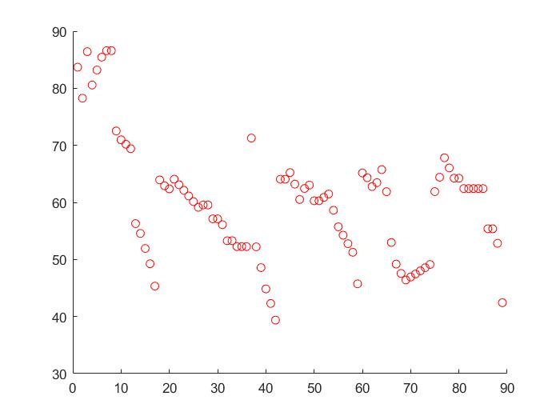
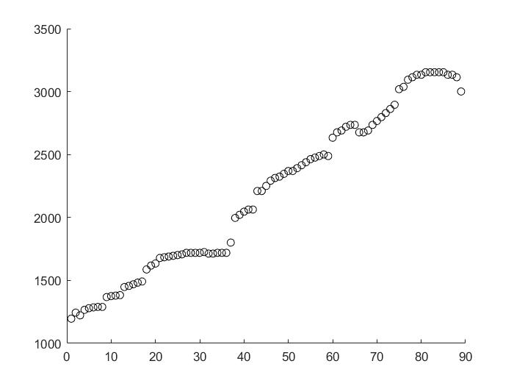
TAKE_1
Assumed that there is only gravitational force applied on the ball, X plot should be a quadratic curve. Y plot and Z plot should be a straight line.
X (vertical)
Y (horizontal)
Z (depth)
mm
mm
mm
nth data
nth data
nth data

Slide 20
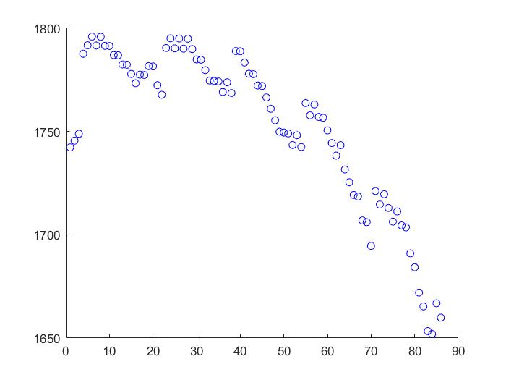
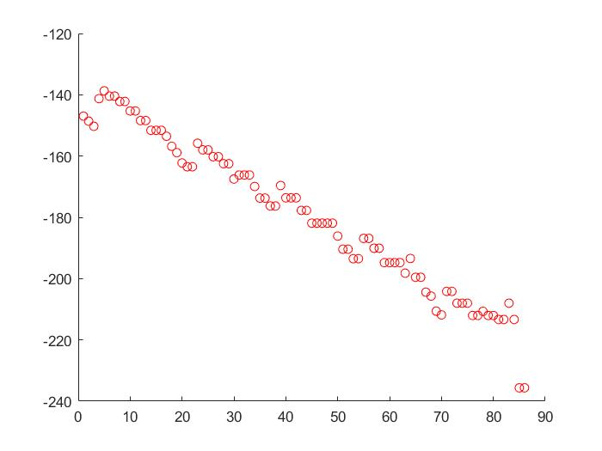
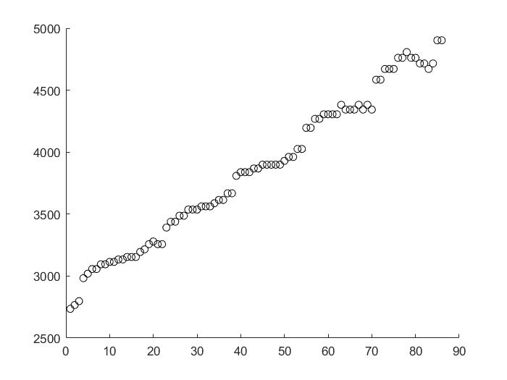
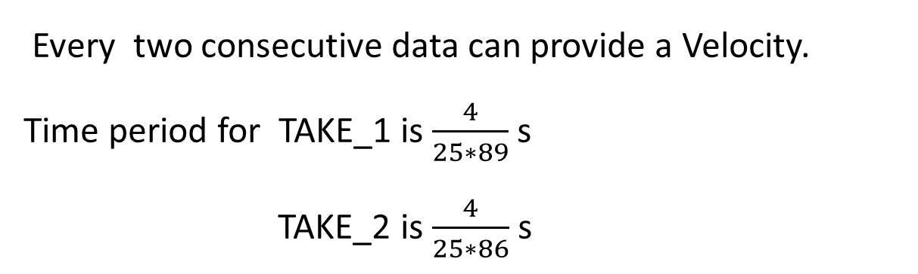
TAKE_2
Every two consecutive data can provide a Velocity.
Time period for TAKE_1 is $\frac{4}{25∗89}$ s
TAKE_2 is $\frac{4}{25∗86}$ s
X (vertical)
Y (horizontal)
Z (depth)
mm
mm
mm
nth data
nth data
nth data

Slide 21
Input Image Sequence
Set up a coordinate system
Preprocessing for Image matching
Data analyzing
Predict the position and velocity

Slide 22
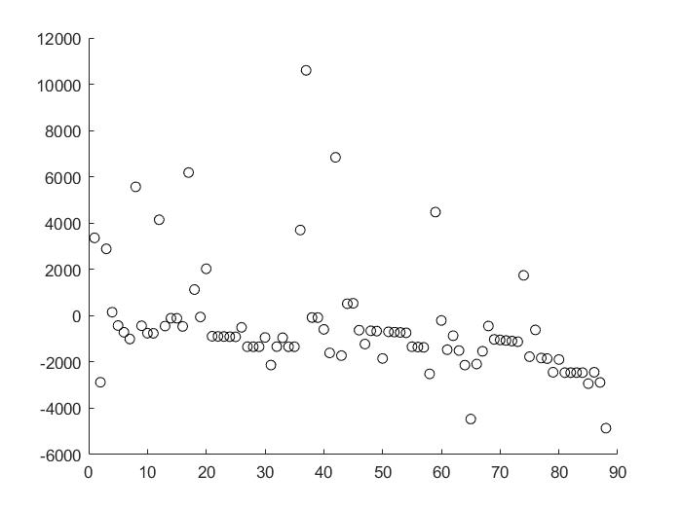
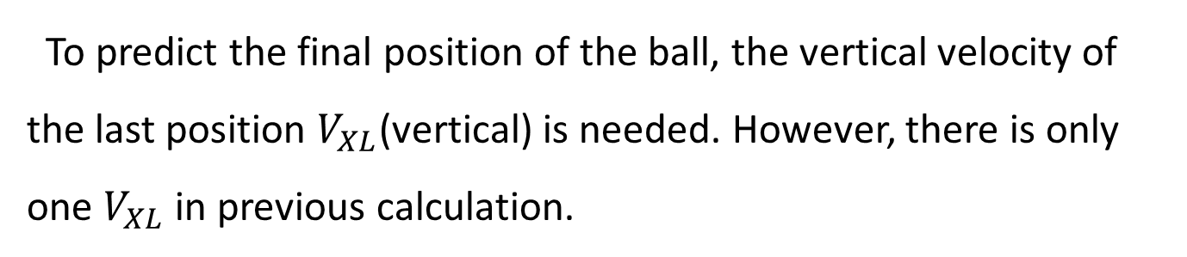
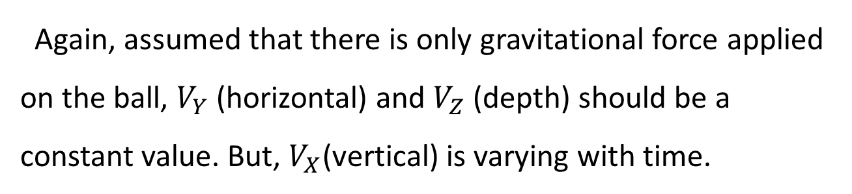

$V_{X}$ (vertical) velocity
mm/s
Again, assumed that there is only gravitational force applied on the ball, $V_{Y}$ (horizontal) and $V_{Z}$ (depth) should be a constant value. But, $V_{X}$(vertical) is varying with time.
nth data
To predict the final position of the ball, the vertical velocity of the last position $V_{XL}$(vertical) is needed. However, there is only one $V_{XL}$ in previous calculation.
$V_{XL}$= $V_{Xn}$ - 9810*$T_{n}$ , $T_{n}$ is the time from nth data to the last data (n=1 to # of data)

Slide 23
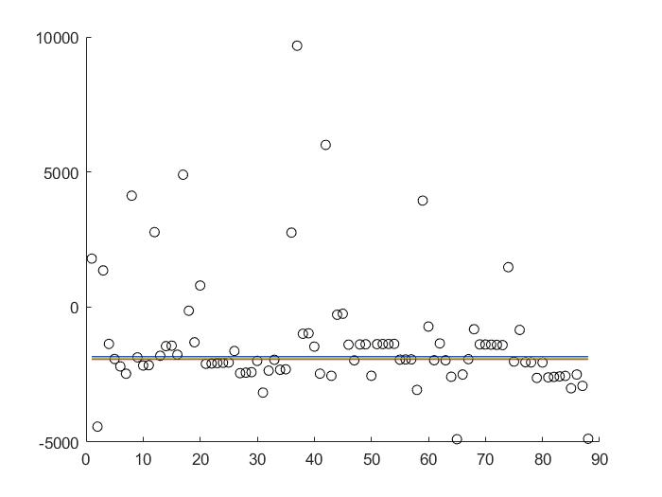
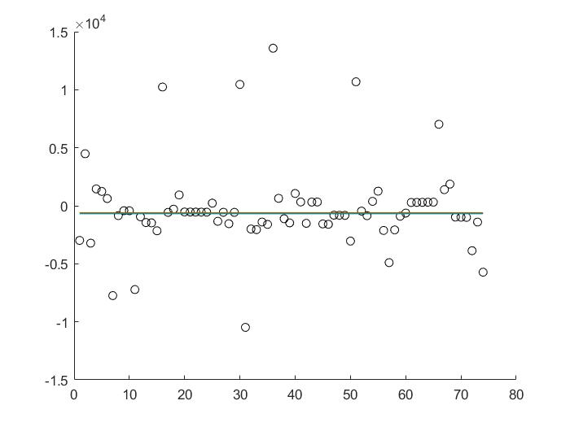
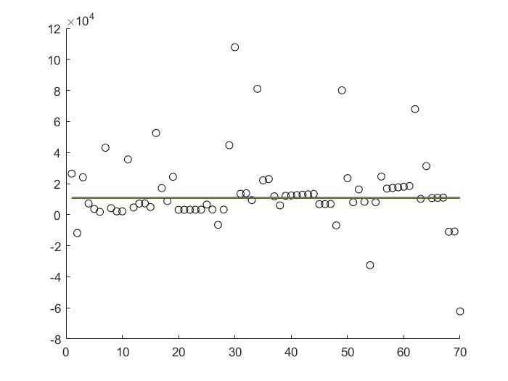
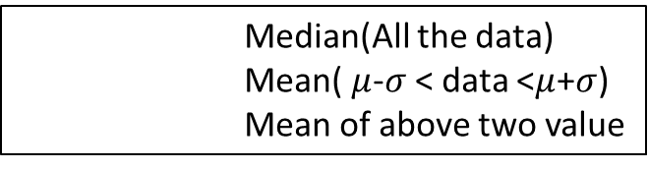



TAKE_1
Median(All the data)
Mean( $μ$-$σ$ < data <$μ$+$σ$)
Mean of above two value
Last position’s vertical velocity
$V_{XL}$ (vertical) velocity
$V_{Y}$ (horizontal) velocity
$V_{Z}$ (depth) velocity
mm/s
mm/s
mm/s
nth data
nth data
nth data

Slide 24
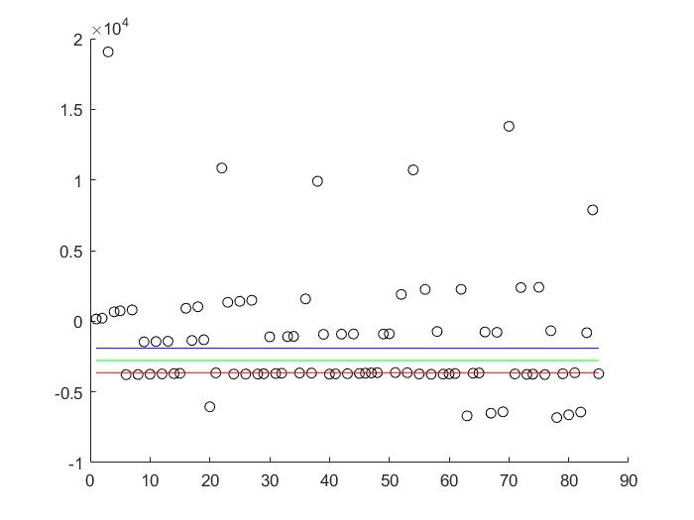
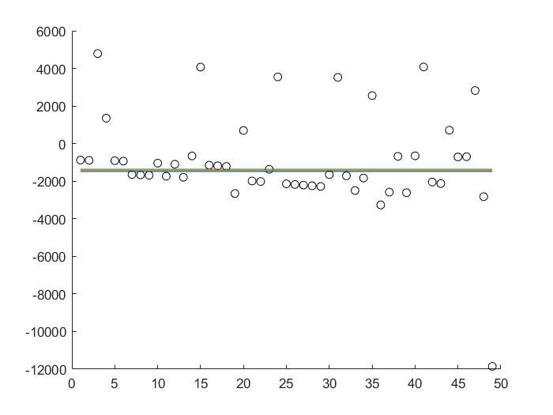
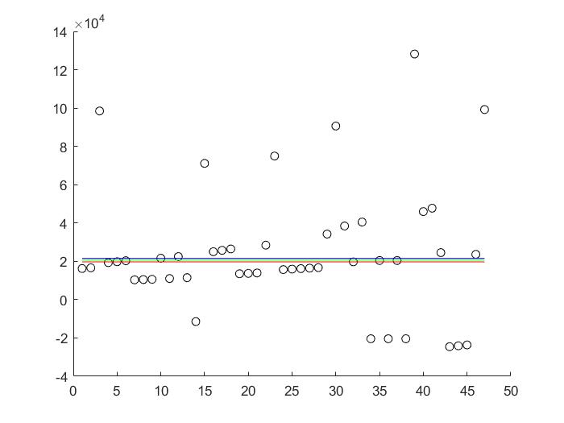




TAKE_2
Median(All the data)
Mean( $μ$-$σ$ < data <$μ$+$σ$)
Mean of above two value
$V_{XL}$ (vertical) velocity
$V_{Y}$ (horizontal) velocity
$V_{Z}$ (depth) velocity
mm/s
mm/s
mm/s
nth data
nth data
nth data

Slide 25
Result

Slide 26
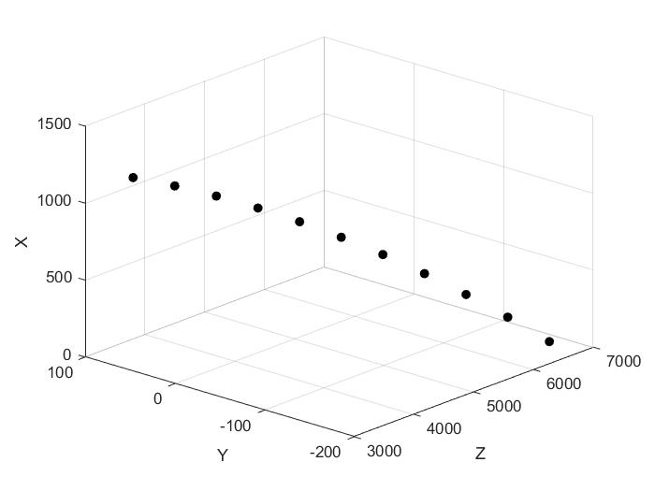
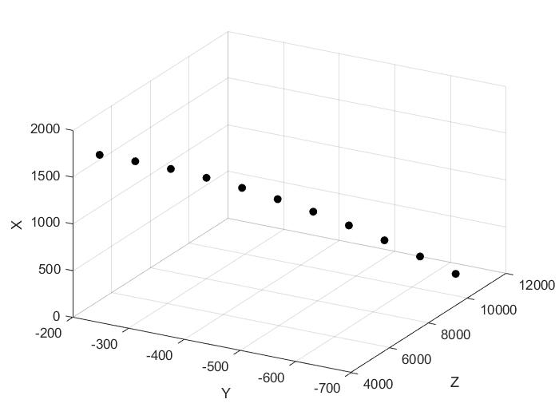
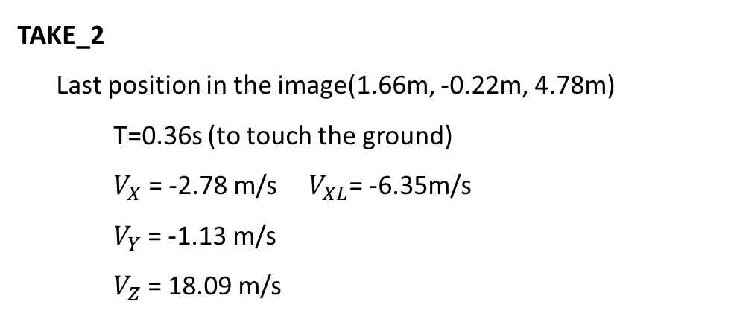
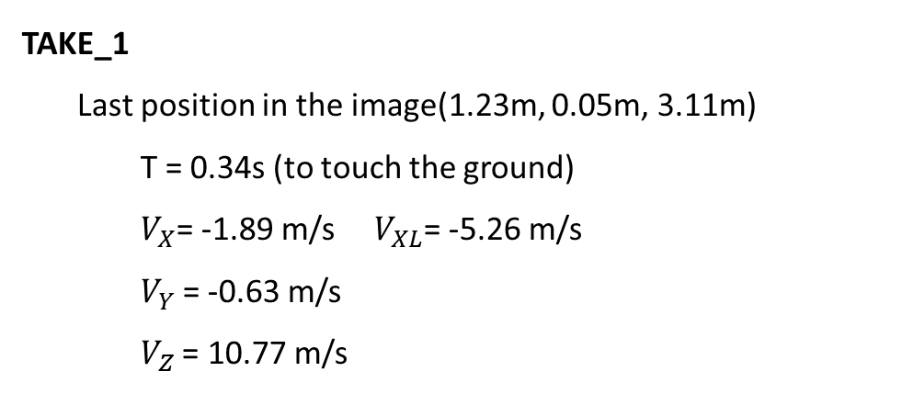
TAKE_1
Last position in the image(1.23m, 0.05m, 3.11m)
T = 0.34s (to touch the ground)
$V_{X}$= -1.89 m/s $V_{XL}$= -5.26 m/s
$V_{Y}$= -0.63 m/s
$V_{Z}$= 10.77 m/s
TAKE_2
Last position in the image(1.66m, -0.22m, 4.78m)
T=0.36s (to touch the ground)
$V_{X}$= -2.78 m/s $V_{XL}$= -6.35m/s
$V_{Y}$= -1.13 m/s
$V_{Z}$= 18.09 m/s
Final position ( 0m, -0.16m, 6.8m )
Final velocity 12.01 m/s
Final position ( 0m, -0.63m, 11.36m )
Final velocity 19.20 m/s
X (vertical)
Y (horizontal)
mm
Z (depth)
mm

